Slide 1
SUPERMARKET MANAGEMENT SYSTEM
By: Rajib Duwal

Slide 2
Introduction
Supermarket Management System is computer program designed to enhance the operation of the supermarket using Data structure and Algorithms in C programming Language.
This System allows tow interfaces: owner and customer which allows to add/remove/upgrade the items available in the market or in the purchase List.

Slide 3
Objectives
Create simple Interface system for owner and customer to simulate market environment.
To display available items in the market along with their price and quantity.
Add, remove or modify the items available in the supermarket.

Slide 4
Key Features
This Supermarket Management System takes user input to add or remove products or to buy the products from the market.
This project uses Singly linked list logic to add /remove or modify the products in the market.

Slide 5
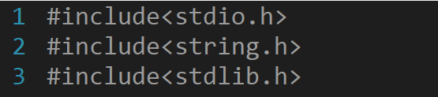
To implement the features of supermarket Management System in C, the header files <stdio.h>, <stdlib.h> and <srting.h> were includedd.These header files provide essential functions for input and output, string manipulation, standard library functions and boolean data type support.

Slide 6
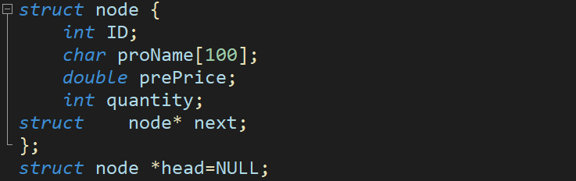
A structure named “Node” was created which store product ID, Name, Price, and quantity of the products . Similarly a Pointer next and head was created to implement the Linked List.

Slide 7
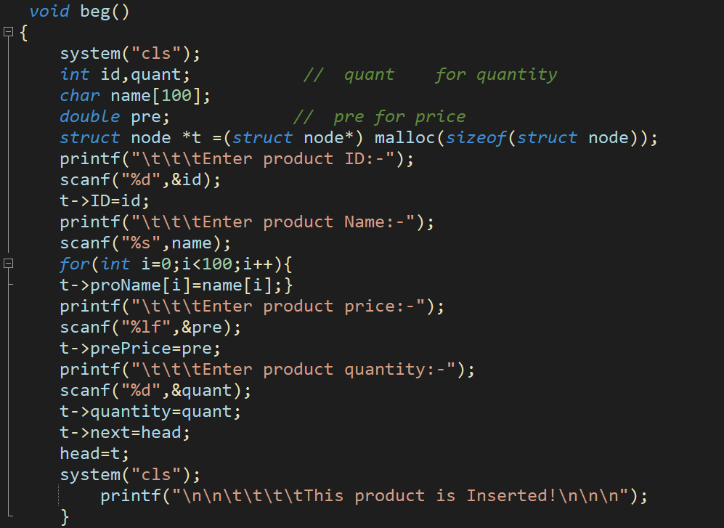
The function “beg” was declared for inserting the items in the linked list.Similary the memory space for new item in the list was allocated using malloc.

Slide 8
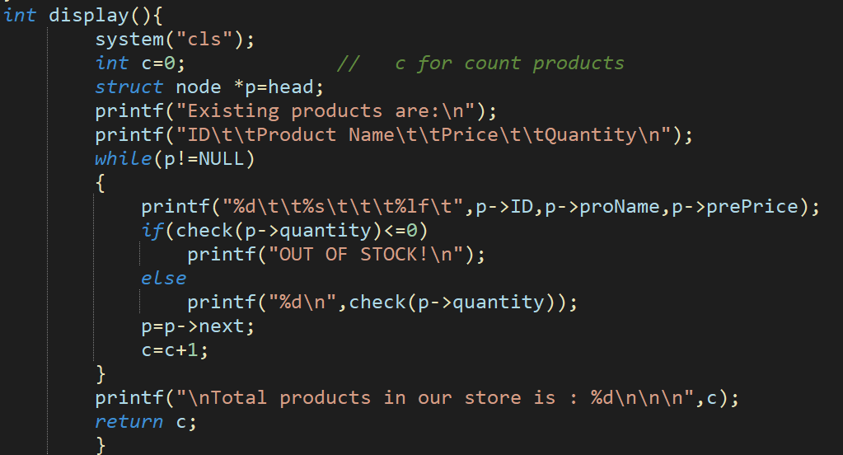
Similarly, the function “display” was declared to display the list of the products available in the market along with their price and available quantities of the product.

Slide 9
Reference
https://stackoverflow.com/questions/61687163/supermarket-simulation-in-c
https://www.slideshare.net/wethecodershelp/supermarket-management-system
https://www.scribd.com/doc/140997151/Supermarket-Management-System-Project-Report#

Slide 10
THANK YOU

